Slide 1


The IMP game Learnability, approximability and adversarial learning beyond $Σ_{1}^{0}$
Information Technology
Michael Brand
Joint work with David L. Dowe
8 February, 2016

Slide 2
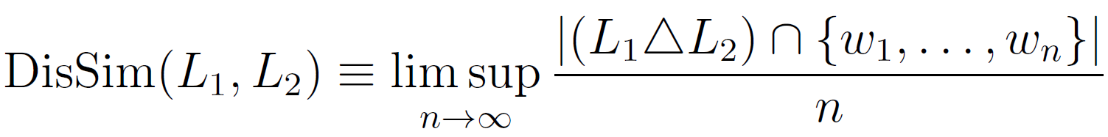
Three questions
Approximability
How much can (well chosen) elements from one set be made to resemble (arbitrary) elements from another set?
We consider languages and
Learning
How well can one predict a sequence by seeing its past elements?
Adversarial learning
Two adversaries try to predict each other’s moves and capitalise on the predictions. How well can each do?
Very hot topic, currently:
Online bidding strategies.
Poisoning attacks.

Slide 3
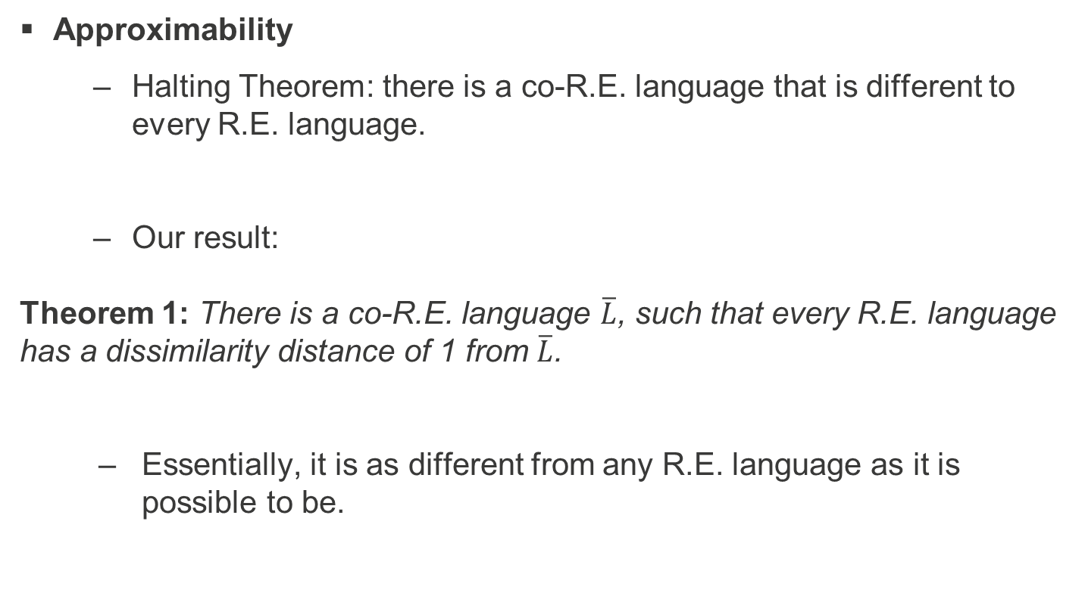
Major results
Approximability
Halting Theorem: there is a co-R.E. language that is different to every R.E. language.
Our result:
Theorem 1: There is a co-R.E. language $\overline{L}$, such that every R.E. language has a dissimilarity distance of 1 from $\overline{L}$.
Essentially, it is as different from any R.E. language as it is possible to be.

Slide 4
Major results (cntd)
Informally:
Learning
Turing machines can learn by example beyond what is computable.
In fact, they can learn all R.E. and all co-R.E. languages (and more).
Adversarial learning
In an iterated game of matching pennies (a.k.a. “odds and evens”), the player choosing “evens” has a decisive advantage.

Slide 5
Caveat
Conclusions inevitably depend on one’s base definitions.
For approximability, for example, we used the DisSim metric, but other distance metrics would have yielded potentially different results.
The same goes for our definition of “to learn” that underpins the “learning” and “adversarial learning” results.
The literature has many definitions of “learnability”:
Solomonoff
E. M. Gold
Statistical Consistency
PAC
etc.
Our definition is not identical to any of these, but has a resemblance to all of them.

Slide 6
Our justifications
We give a single, unified framework within which all three problems (approximability, learnability, adversarial learning) can be investigated.
We want to explore the “game” aspects of adversarial learning, so naturally integrate tools from game theory (e.g., mixed strategies, Nash equilibria).
We begin by analysing adversarial learning, then take the other cases as special cases.
Traditional approaches typically begin with “learning”, and need special provisions for adversarial learning, sometimes losing entirely the “game” character and reducing the process to a one-player game.
We believe that our approach, retaining the “game” elements, is more natural.
The results are interesting!

Slide 7
The IMP set-up

Slide 8



A game of matching pennies
Player “=“
Player “≠“
Accept/Reject
Accept/Reject

Slide 9


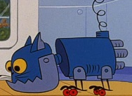



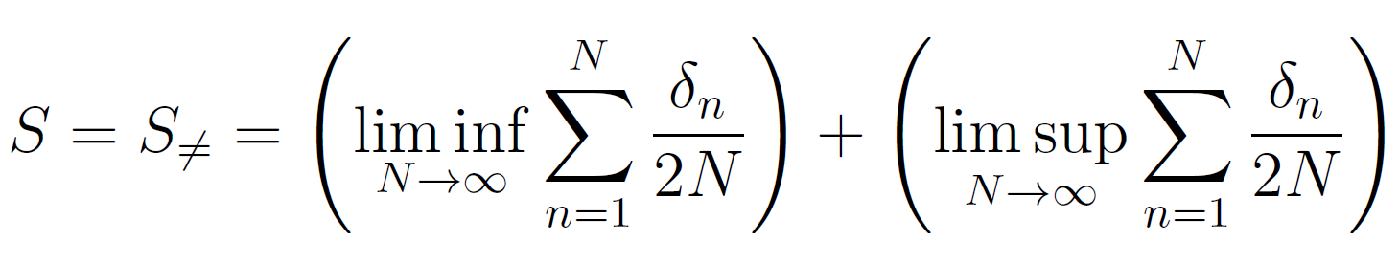
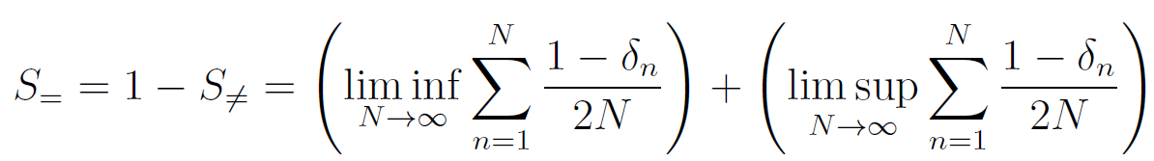
An iterated game of matching pennies
Player “=“
Player “≠“
Accept/Reject
Accept/Reject
Agent
Agent
Final payoffs?
Inspector

Slide 10
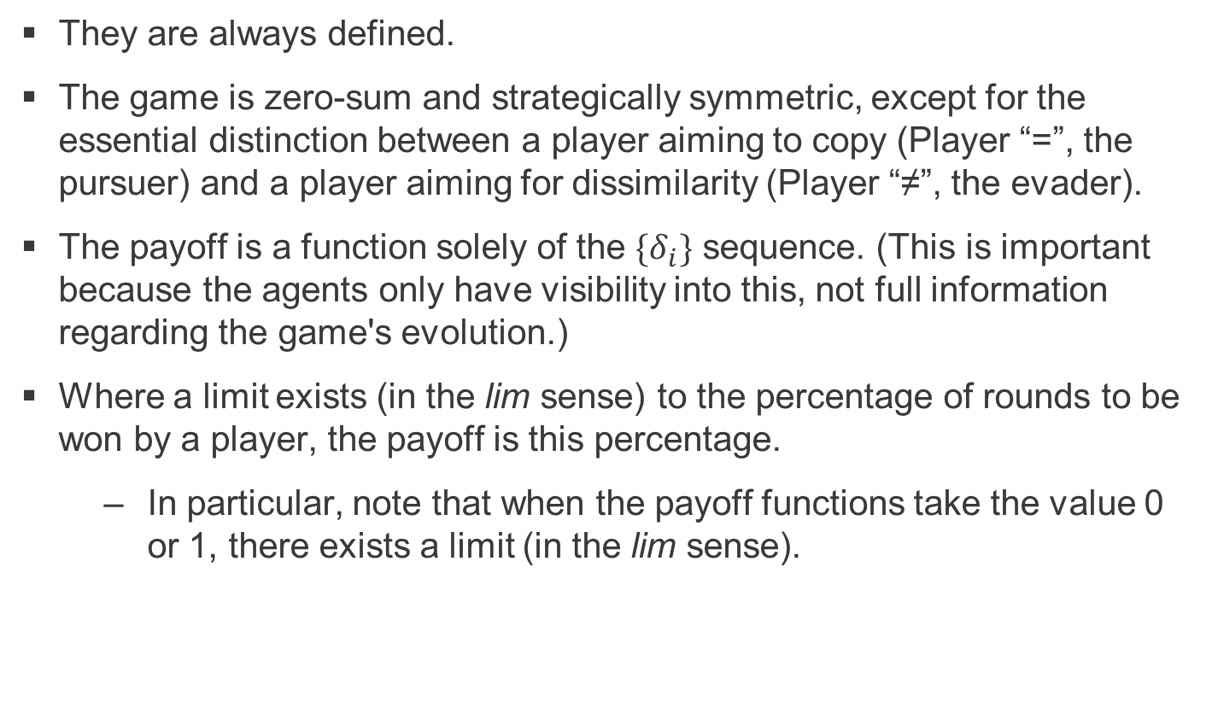
Why the strange payoffs?
They are always defined.
The game is zero-sum and strategically symmetric, except for the essential distinction between a player aiming to copy (Player “=”, the pursuer) and a player aiming for dissimilarity (Player “≠”, the evader).
The payoff is a function solely of the $\{δ_{i}\}$ sequence. (This is important because the agents only have visibility into this, not full information regarding the game's evolution.)
Where a limit exists (in the lim sense) to the percentage of rounds to be won by a player, the payoff is this percentage.
In particular, note that when the payoff functions take the value 0 or 1, there exists a limit (in the lim sense).

Slide 11
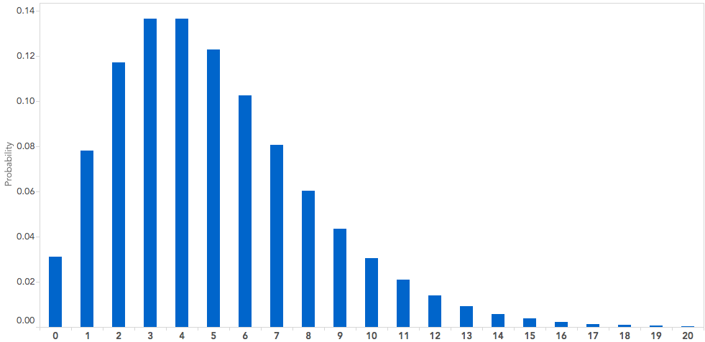
An iterated game of matching pennies
Player “=“
Player “≠“
Accept/Reject
Accept/Reject
Agent
Agent
Strategy
Strategy
Mixed strategy = distribution
Inspector
Mixed strategy = distribution

Slide 12

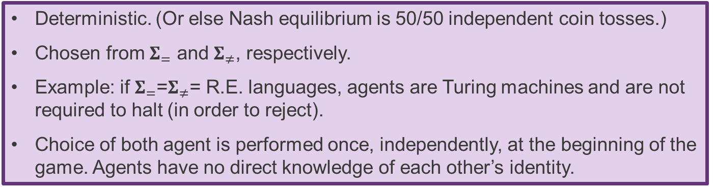
The IMP game: $IMP(Σ_{=},Σ_{≠})$
Accept/Reject
Accept/Reject
L≠
L₌
Agent
Agent
Deterministic. (Or else Nash equilibrium is 50/50 independent coin tosses.)
Chosen from $Σ_{=}$ and $Σ_{≠}$, respectively.
Example: if $Σ_{=}$=$Σ_{≠}$= R.E. languages, agents are Turing machines and are not required to halt (in order to reject).
Choice of both agent is performed once, independently, at the beginning of the game. Agents have no direct knowledge of each other’s identity.

Slide 13
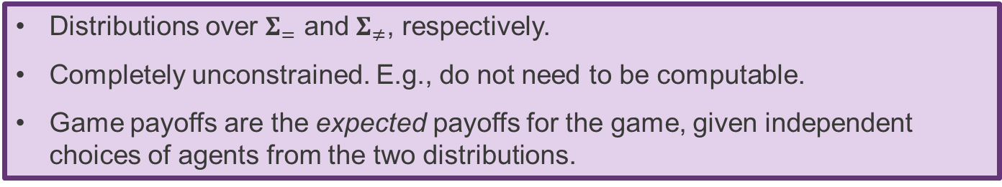
The IMP game: $IMP(Σ_{=},Σ_{≠})$
Player “=“ strategy
Player “≠“ strategy
Accept/Reject
Accept/Reject
L≠
L₌
D₌
D≠
Agent
Agent
Distributions over $Σ_{=}$ and $Σ_{≠}$, respectively.
Completely unconstrained. E.g., do not need to be computable.
Game payoffs are the expected payoffs for the game, given independent choices of agents from the two distributions.

Slide 14
The IMP game: $IMP(Σ_{=},Σ_{≠})$
Player “=“ strategy
Player “≠“ strategy
Accept/Reject
Accept/Reject
L≠
L₌
D₌
D≠
Agent
Agent
Oracle.
Does not need to be computable.
Performs a xor over accept/reject choices.
Observation:
The key to enabling the learning from examples of incomputable functions is to have a method to generate the examples...
Inspector

Slide 15
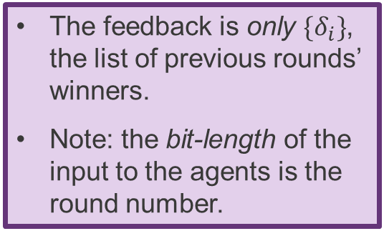
The IMP game: $IMP(Σ_{=},Σ_{≠})$
Player “=“ strategy
Player “≠“ strategy
Accept/Reject
Accept/Reject
L≠
L₌
D₌
D≠
Agent
Agent
Agents are effectively “restarted” at every iteration.
The feedback from the inspector is their input string.
The feedback is only $\{δ_{i}\}$, the list of previous rounds’ winners.
Note: the bit-length of the input to the agents is the round number.
Inspector

Slide 16
Reminder of some (standard) definitions we’ll use

Slide 17





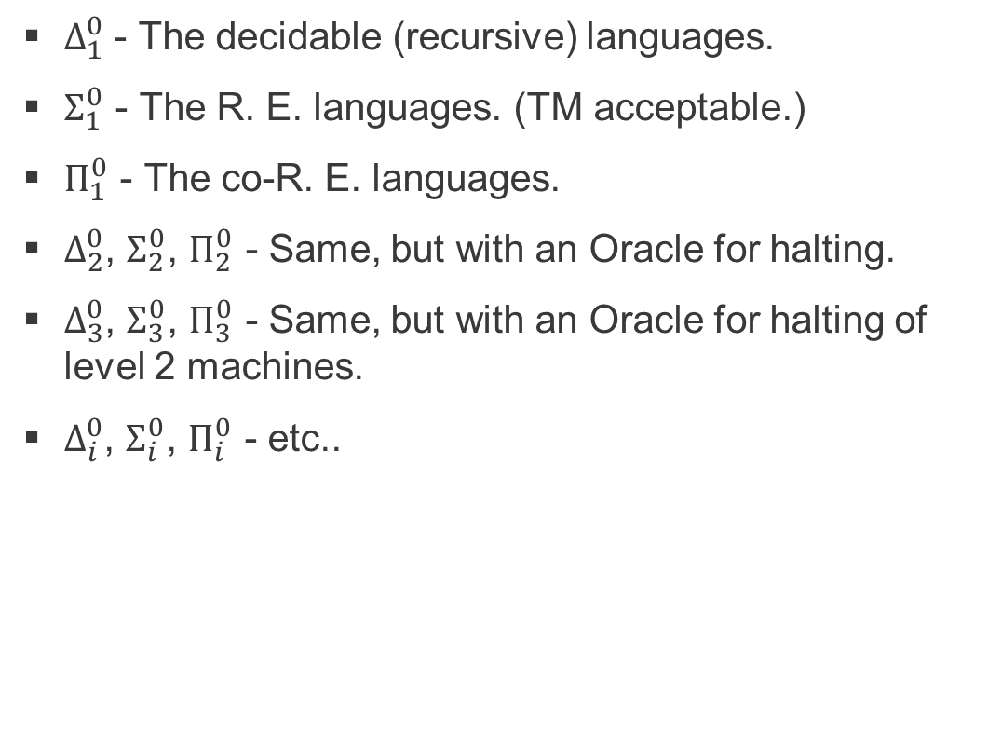







The Arithmetical Hierarchy
$Δ_{1}^{0}$ - The decidable (recursive) languages.
$Σ_{1}^{0}$ - The R. E. languages. (TM acceptable.)
$Π_{1}^{0}$ - The co-R. E. languages.
$Δ_{2}^{0}$, $Σ_{2}^{0}$, $Π_{2}^{0}$ - Same, but with an Oracle for halting.
$Δ_{3}^{0}$, $Σ_{3}^{0}$, $Π_{3}^{0}$ - Same, but with an Oracle for halting of level 2 machines.
$Δ_{i}^{0}$, $Σ_{i}^{0}$, $Π_{i}^{0}$ - etc..
$$Σ_{i}^{0}$$
$$Π_{i}^{0}$$
$$Δ_{i}^{0}$$
$$Σ_{3}^{0}$$
$$Π_{3}^{0}$$
$$Δ_{3}^{0}$$
$$Σ_{2}^{0}$$
$$Π_{2}^{0}$$
$$Δ_{2}^{0}$$
$$Σ_{1}^{0}$$
$$Π_{1}^{0}$$
$$Δ_{1}^{0}$$

Slide 18
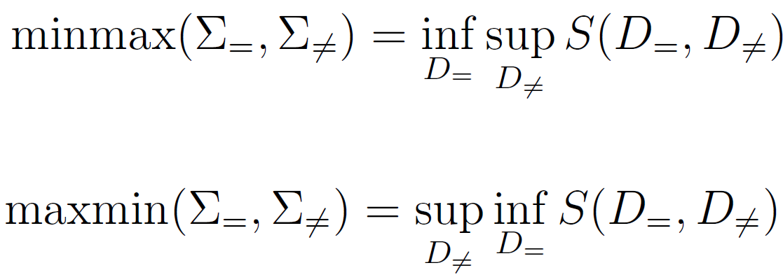
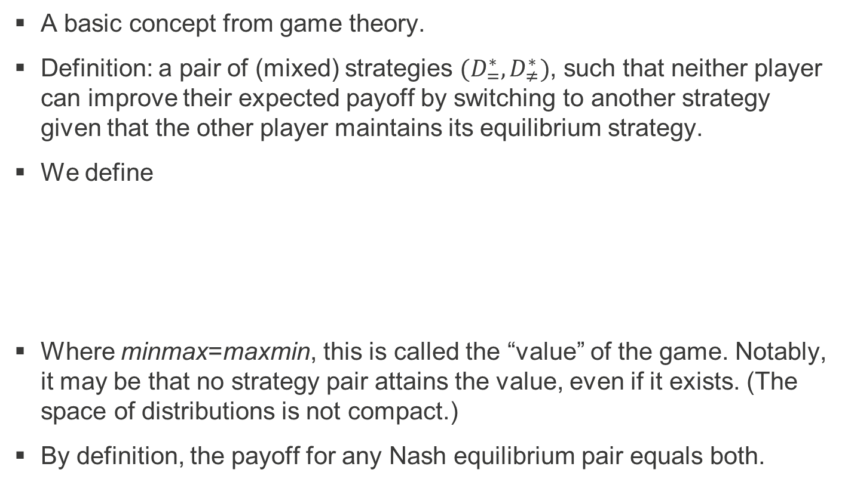
Nash equilibrium
A basic concept from game theory.
Definition: a pair of (mixed) strategies $(D_{=}^{∗},D_{≠}^{∗})$, such that neither player can improve their expected payoff by switching to another strategy given that the other player maintains its equilibrium strategy.
We define
Where minmax=maxmin, this is called the “value” of the game. Notably, it may be that no strategy pair attains the value, even if it exists. (The space of distributions is not compact.)
By definition, the payoff for any Nash equilibrium pair equals both.

Slide 19
Warm-up: halting Turing machines

Slide 20
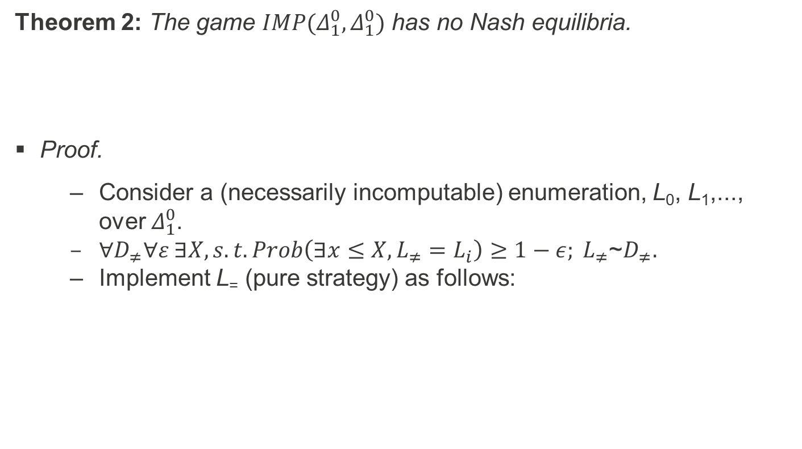
Characterisation of Nash equilibria
Theorem 2: The game $IMP(Δ_{1}^{0},Δ_{1}^{0})$ has no Nash equilibria.
Proof.
Consider a (necessarily incomputable) enumeration, L₀, L₁,..., over $Δ_{1}^{0}$.
${∀D}_{≠}∀ε ∃X, s.t. Prob\left(∃x≤X, L_{≠}=L_{i}\right)≥1−ε; L_{≠}$~$D_{≠}.$
Implement L₌ (pure strategy) as follows:

Slide 21
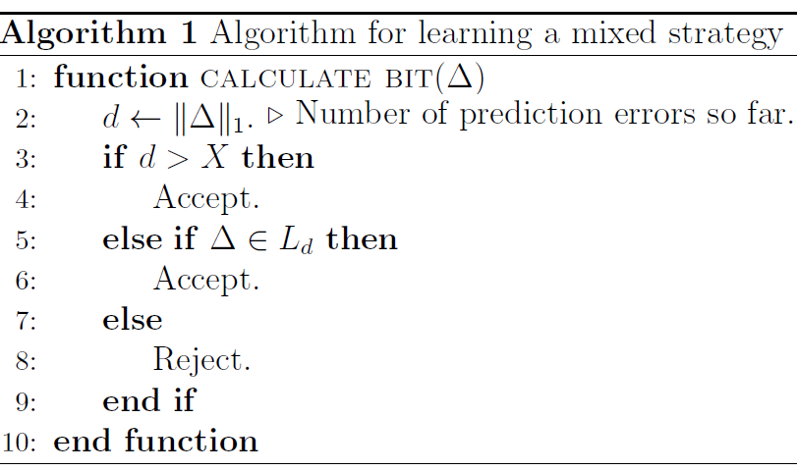
Will make at most X errors w.p. 1-ε, so maxmin=0.
Note: L₀,...,L_{X} can be finitely encoded by (finite) T₀,...,T_{X}.
Symmetrically, for any D₌, define L≠ to prove minmax=1.
Because maxmin≠minmax, no Nash equilibrium exists.
Only change needed.

Slide 22
The general case

Slide 23
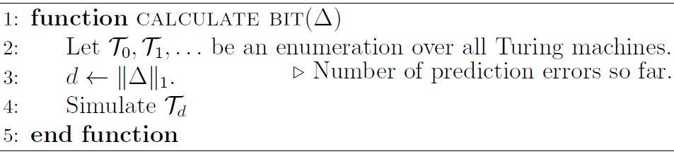
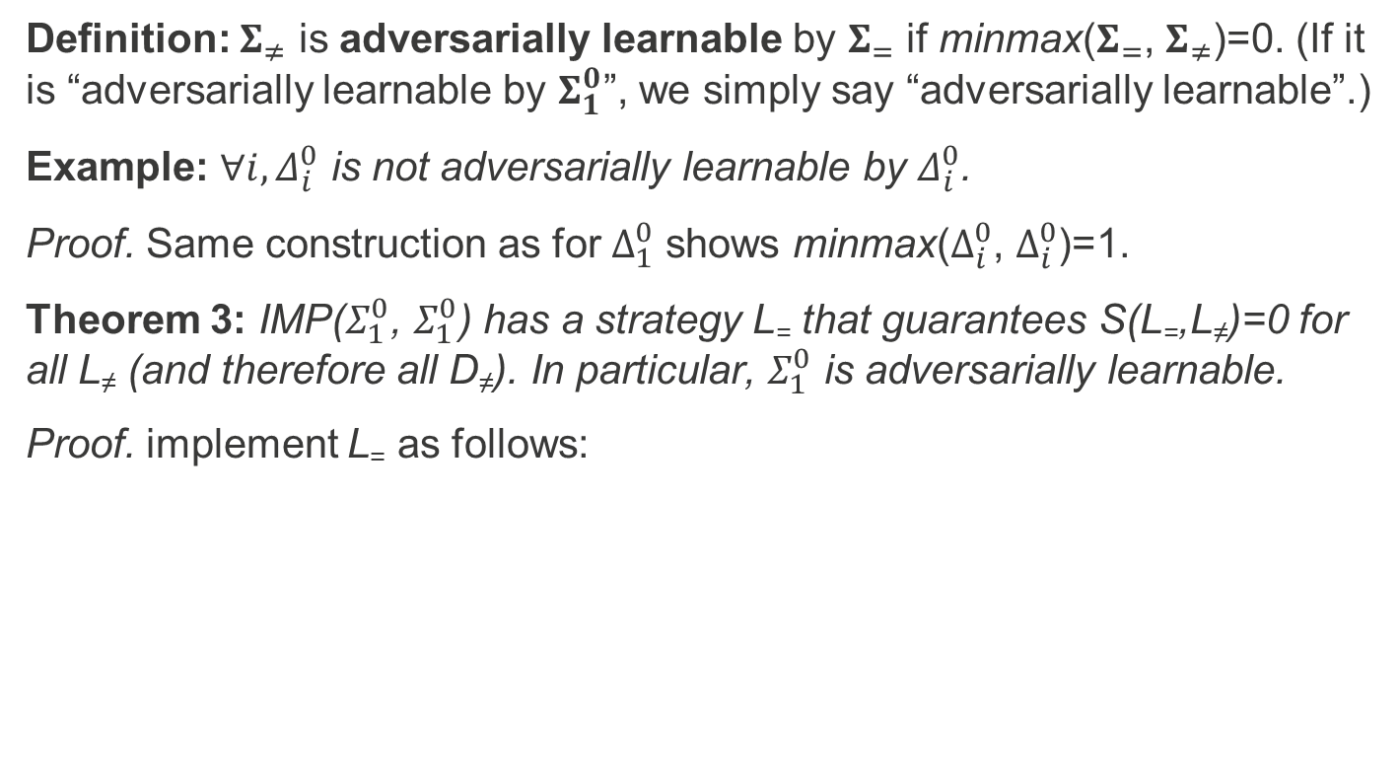
Adversarial learnability
Definition: $Σ_{≠}$ is adversarially learnable by $Σ_{=}$ if minmax($Σ_{=}$, $Σ_{≠}$)=0. (If it is “adversarially learnable by $Σ_{1}^{0}$”, we simply say “adversarially learnable”.)
Example: $∀i, Δ_{i}^{0}$ is not adversarially learnable by $Δ_{i}^{0}$.
Proof. Same construction as for $Δ_{1}^{0}$ shows minmax($Δ_{i}^{0}$, $Δ_{i}^{0}$)=1.
Theorem 3: IMP($Σ_{1}^{0}$, $Σ_{1}^{0}$) has a strategy L₌ that guarantees S(L₌,L≠)=0 for all L≠ (and therefore all D≠). In particular, $Σ_{1}^{0}$ is adversarially learnable.
Proof. implement L₌ as follows:
Can only lose a finite number of rounds against any agent!

Slide 24

Adversarial learnability (cntd)
Corollary: For all i>0, $Σ_{i}^{0}$ is adversarially learnable by $Σ_{i}^{0}$ but not by $Π_{i}^{0}$; $Π_{i}^{0}$ is adversarially learnable by $Π_{i}^{0}$ but not by $Σ_{i}^{0}$.
Proof. Previous algorithm shows learnability. Non-learnability is shown by symmetry: if Player “=“ has a winning strategy, the other does not.

Slide 25
Conventional learning

Slide 26
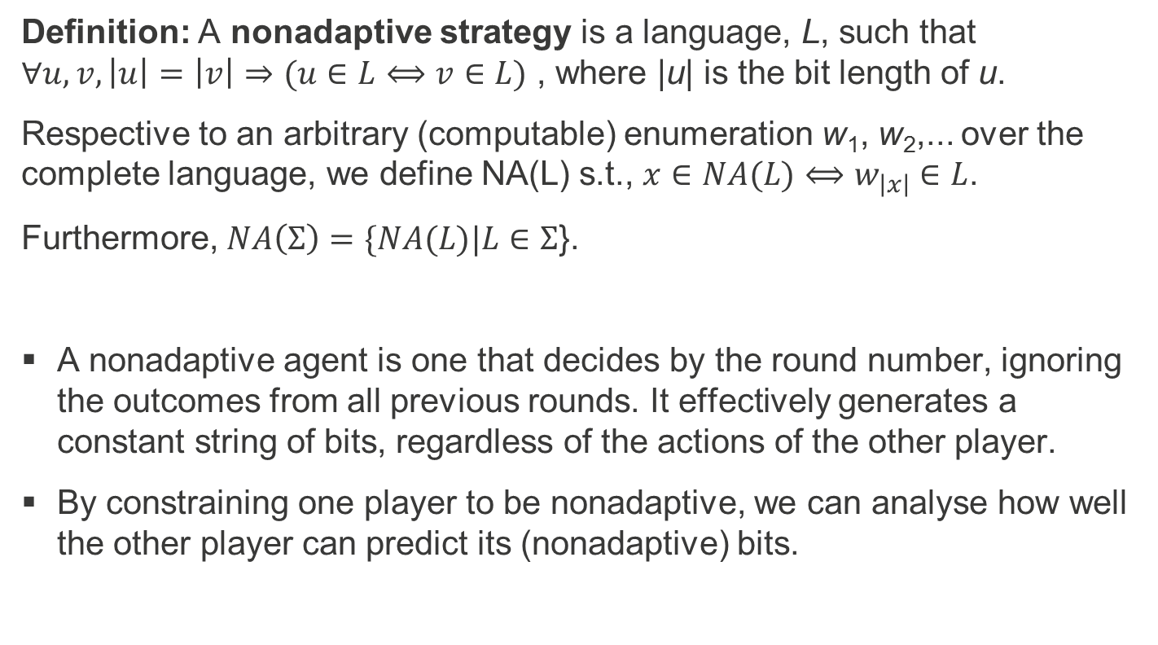
Nonadaptive strategies
Definition: A nonadaptive strategy is a language, L, such that $∀u,v, \left|u\right|=\left|v\right|⇒(u∈L⟺v∈L)$ , where |u| is the bit length of u.
Respective to an arbitrary (computable) enumeration w₁, w₂,... over the complete language, we define NA(L) s.t., $x∈NA(L)⟺w_{\left|x\right|}∈L$.
Furthermore, $NA\left(Σ\right)=\{NA(L)|L∈Σ$}.
A nonadaptive agent is one that decides by the round number, ignoring the outcomes from all previous rounds. It effectively generates a constant string of bits, regardless of the actions of the other player.
By constraining one player to be nonadaptive, we can analyse how well the other player can predict its (nonadaptive) bits.

Slide 27
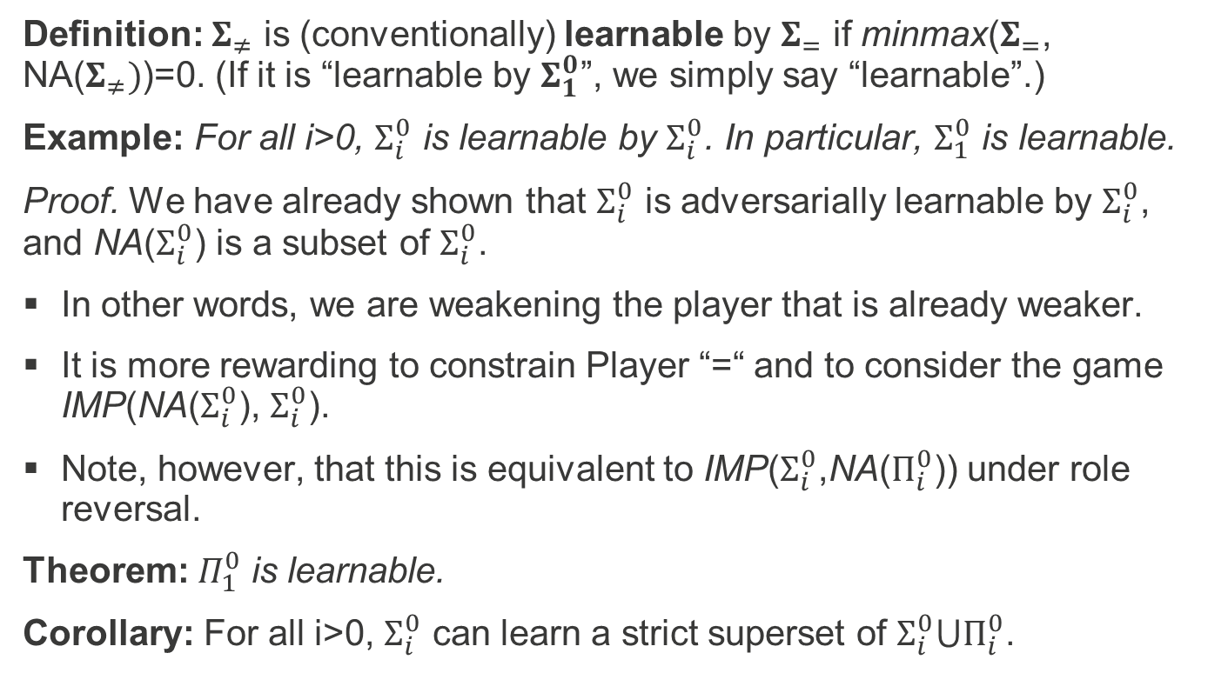
Conventional learnability
Definition: $Σ_{≠}$ is (conventionally) learnable by $Σ_{=}$ if minmax($Σ_{=}$, NA($Σ_{≠})$)=0. (If it is “learnable by $Σ_{1}^{0}$”, we simply say “learnable”.)
Example: For all i>0, $Σ_{i}^{0}$ is learnable by $Σ_{i}^{0}$. In particular, $Σ_{1}^{0}$ is learnable.
Proof. We have already shown that $Σ_{i}^{0}$ is adversarially learnable by $Σ_{i}^{0}$, and NA($Σ_{i}^{0}$) is a subset of $Σ_{i}^{0}$.
In other words, we are weakening the player that is already weaker.
It is more rewarding to constrain Player “=“ and to consider the game IMP(NA($Σ_{i}^{0}$), $Σ_{i}^{0}$).
Note, however, that this is equivalent to IMP($Σ_{i}^{0}$,NA($Π_{i}^{0}$)) under role reversal.
Theorem: $Π_{1}^{0}$ is learnable.
Corollary: For all i>0, $Σ_{i}^{0}$ can learn a strict superset of $Σ_{i}^{0}⋃Π_{i}^{0}$.

Slide 28
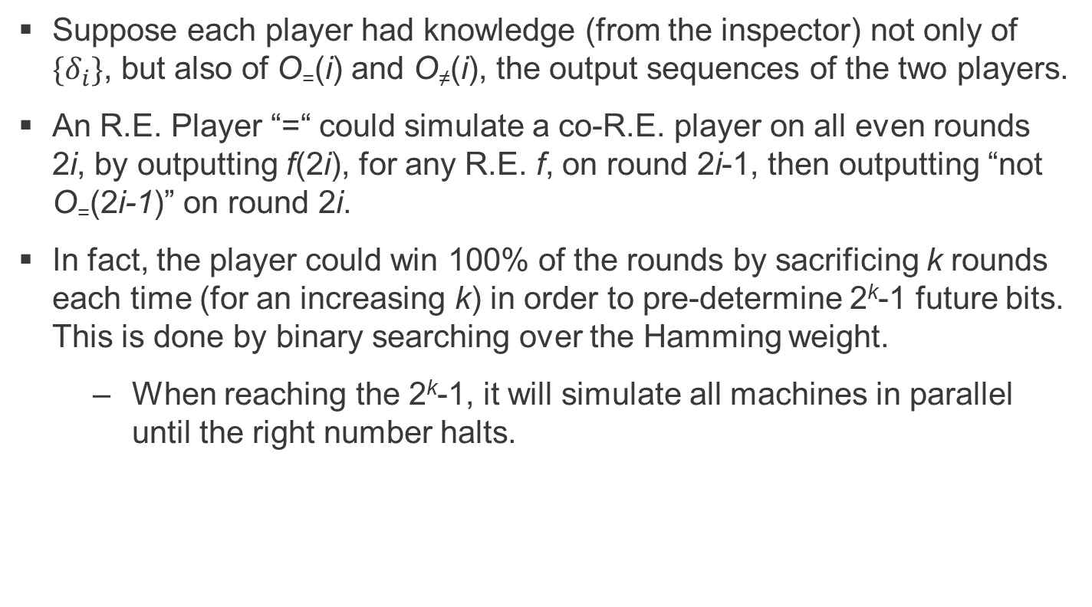
Proof (general idea)
Suppose each player had knowledge (from the inspector) not only of $\{δ_{i}\}$, but also of O₌(i) and O≠(i), the output sequences of the two players.
An R.E. Player “=“ could simulate a co-R.E. player on all even rounds 2i, by outputting f(2i), for any R.E. f, on round 2i-1, then outputting “not O₌(2i-1)” on round 2i.
In fact, the player could win 100% of the rounds by sacrificing k rounds each time (for an increasing k) in order to pre-determine 2^{k}-1 future bits. This is done by binary searching over the Hamming weight.
When reaching the 2^{k}-1, it will simulate all machines in parallel until the right number halts.

Slide 29
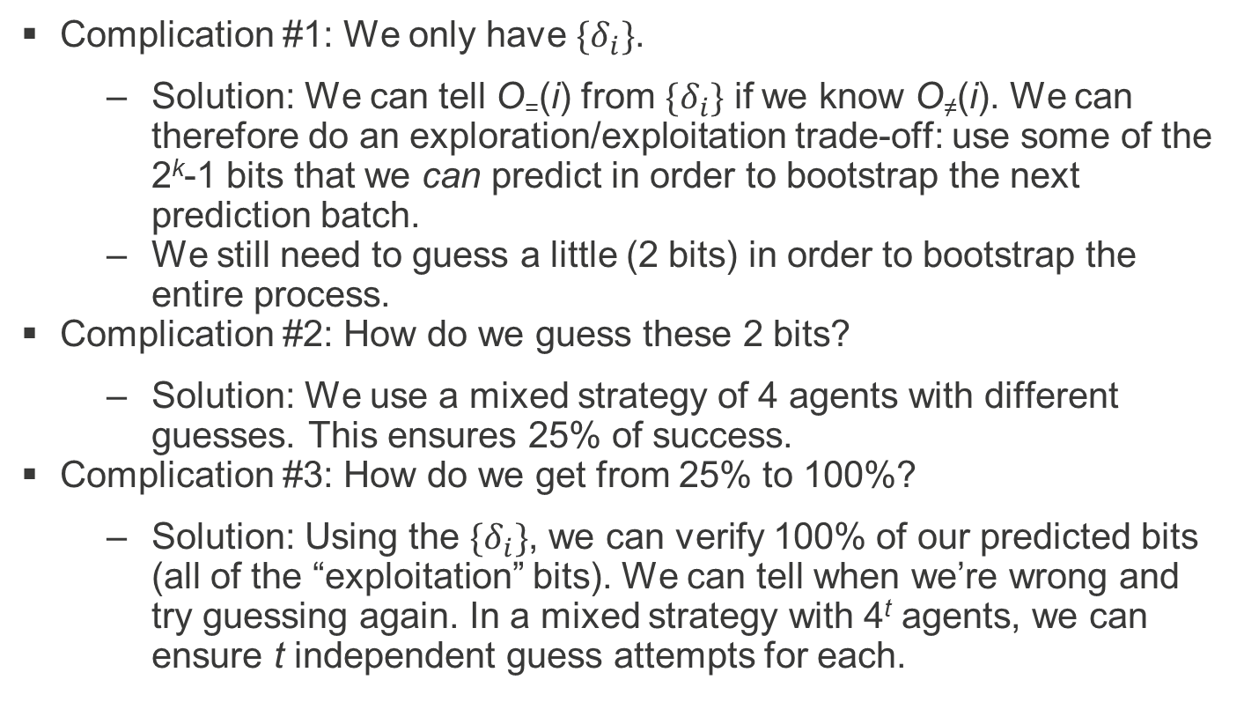
Proof (cntd)
Complication #1: We only have $\{δ_{i}\}$.
Solution: We can tell O₌(i) from $\{δ_{i}\}$ if we know O≠(i). We can therefore do an exploration/exploitation trade-off: use some of the 2^{k}-1 bits that we can predict in order to bootstrap the next prediction batch.
We still need to guess a little (2 bits) in order to bootstrap the entire process.
Complication #2: How do we guess these 2 bits?
Solution: We use a mixed strategy of 4 agents with different guesses. This ensures 25% of success.
Complication #3: How do we get from 25% to 100%?
Solution: Using the $\{δ_{i}\}$, we can verify 100% of our predicted bits (all of the “exploitation” bits). We can tell when we’re wrong and try guessing again. In a mixed strategy with 4^{t} agents, we can ensure t independent guess attempts for each.

Slide 30
Proof (cntd)
Complication #4: After the first guess, all remaining t-1 guesses happen at different rounds among the different agents. How can we ensure a 25% success rate for each guess?
Solution: We make sure all guesses are synchronised between agents. The way to do this is to pre-allocate for each of the t guesses an infinite sequence of rounds, such that in total these rounds amount to a density of 0 among all rounds. Each guess retains its pre-allocated rounds until it is falsified. Guesses all happen in pre-allocated places within these pre-allocated rounds.
The remaining rounds (forming the overwhelming majority) are used by the current “best guess”: the lowest-numbered hypothesis yet to be falsified.
Total success rate: 1-0.75^{t}, for a sup of 1, as required.

Slide 31
Proof (cntd)
Complication #5: But we don’t know which co-R.E. function to emulate...
Solution: Instead of having t hypotheses, we have an infinite number of hypotheses, t for each co-R.E. function. We enumerate over all.
We pre-allocate an infinite number of bits to each of these infinite hypotheses, while still maintaining that their total density is 0.
Notably, if our learner was probabilistic, there was no need for a mixed strategy.
Although this, too, has its own complications...
However, we are able to prove that no pure-strategy deterministic agent can learn the co-R.E. languages.
This is a case where stochastic TMs have a provable advantage.

Slide 32
Approximation

Slide 33
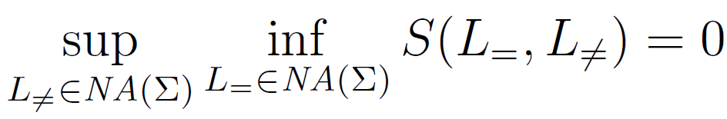
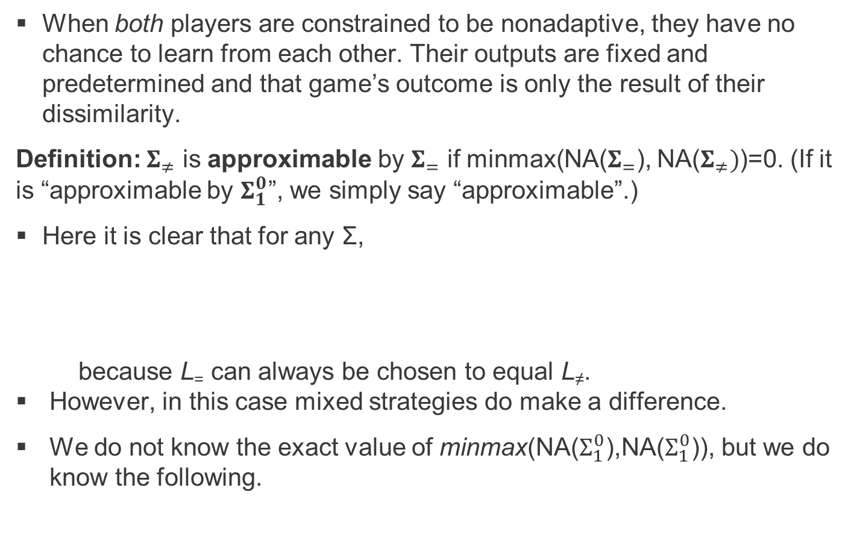
When both players are constrained to be nonadaptive, they have no chance to learn from each other. Their outputs are fixed and predetermined and that game’s outcome is only the result of their dissimilarity.
Definition: $Σ_{≠}$ is approximable by $Σ_{=}$ if minmax(NA($Σ_{=}$), NA($Σ_{≠})$)=0. (If it is “approximable by $Σ_{1}^{0}$”, we simply say “approximable”.)
Here it is clear that for any Σ,
because L₌ can always be chosen to equal L≠.
However, in this case mixed strategies do make a difference.
We do not know the exact value of minmax(NA($Σ_{1}^{0}$),NA($Σ_{1}^{0}$)), but we do know the following.

Slide 34
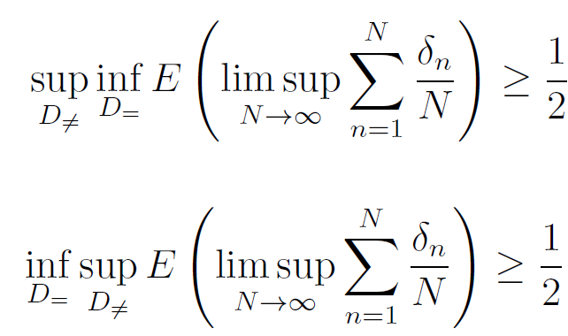
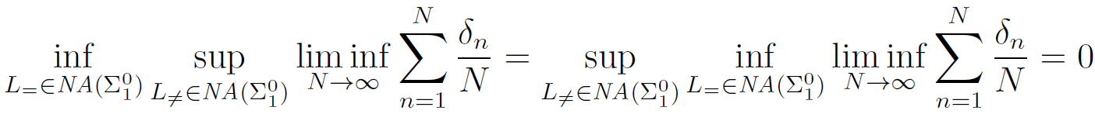
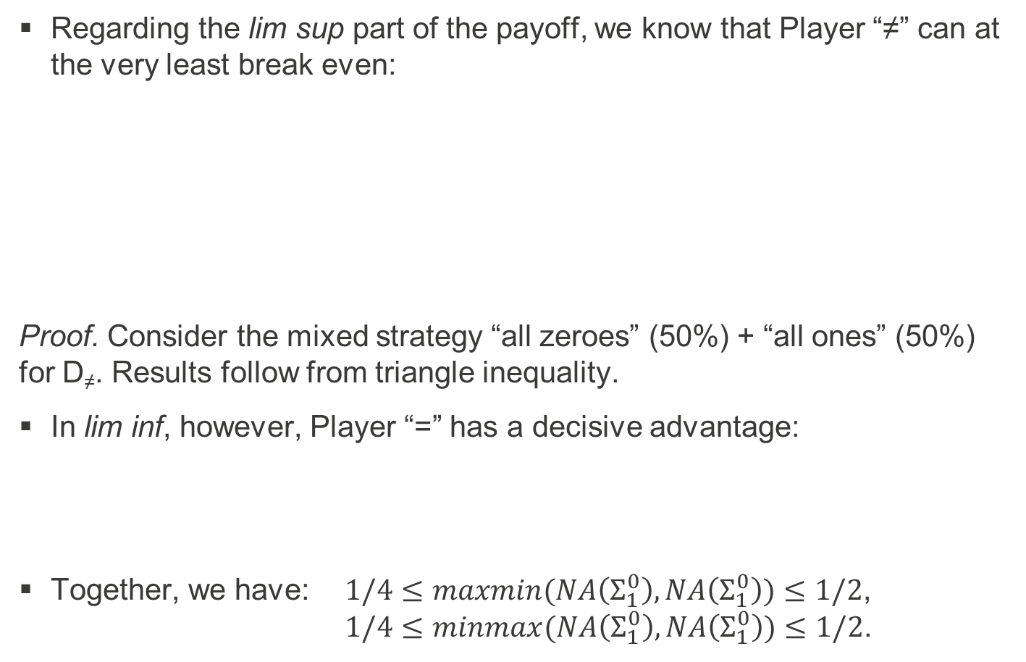
Regarding the lim sup part of the payoff, we know that Player “≠” can at the very least break even:
Proof. Consider the mixed strategy “all zeroes” (50%) + “all ones” (50%) for D≠. Results follow from triangle inequality.
In lim inf, however, Player “=” has a decisive advantage:
Together, we have: $1/4≤maxmin(NA\left(Σ_{1}^{0}\right),NA\left(Σ_{1}^{0}\right))≤1/2$, $1/4≤minmax(NA\left(Σ_{1}^{0}\right),NA\left(Σ_{1}^{0}\right))≤1/2$.

Slide 35

Proof of lim inf claim
triangle(x) := 0,0,1,0,1,2,0,1,2,3,0,1,2,3,4,0,1,2,3,4,5,...
caf(x) := maximum y s.t. y!≤x.
Define L₌ by
L₌ emulates each language an infinite number of times.
Each time, it does so for a length that becomes an increasing proportion (with a lim of 1) of the total number of rounds so far.
Consider the subsequence relating to the correct guess for L≠. This gives the lim inf result.

Slide 36
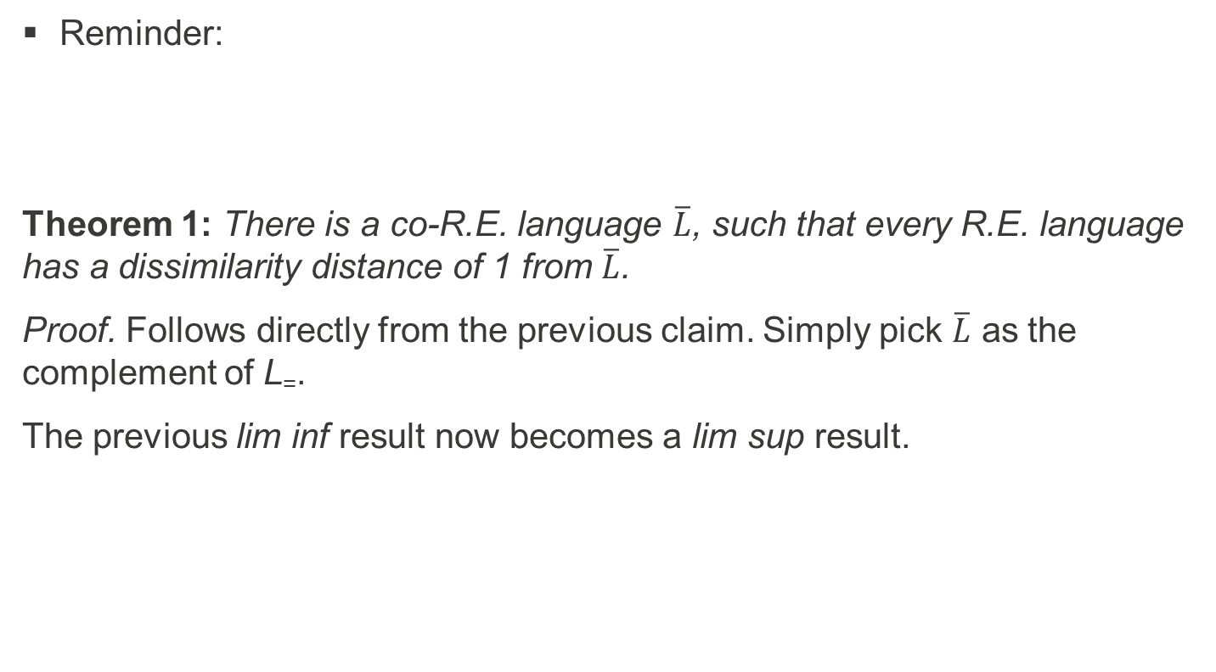
Proof of Theorem 1
Reminder:
Theorem 1: There is a co-R.E. language $\overline{L}$, such that every R.E. language has a dissimilarity distance of 1 from $\overline{L}$.
Proof. Follows directly from the previous claim. Simply pick $\overline{L}$ as the complement of L₌.
The previous lim inf result now becomes a lim sup result.

Slide 37
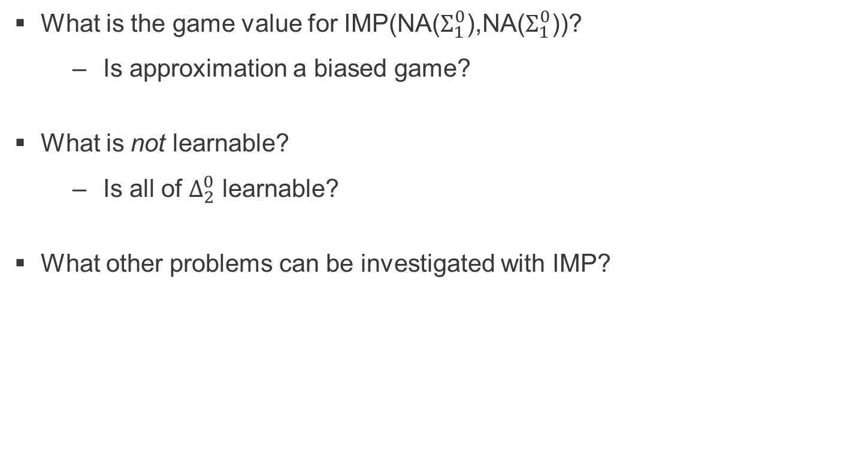
Some open questions
What is the game value for IMP(NA($Σ_{1}^{0}$),NA($Σ_{1}^{0}$))?
Is approximation a biased game?
What is not learnable?
Is all of $Δ_{2}^{0}$ learnable?
What other problems can be investigated with IMP?

Slide 38
Questions?
Thank you!

